Slide 1
Used Car Analysis
Ziyue Zhong / Qinruo Wu
Shuangjie Ma / Wenxuan Tan

Slide 2
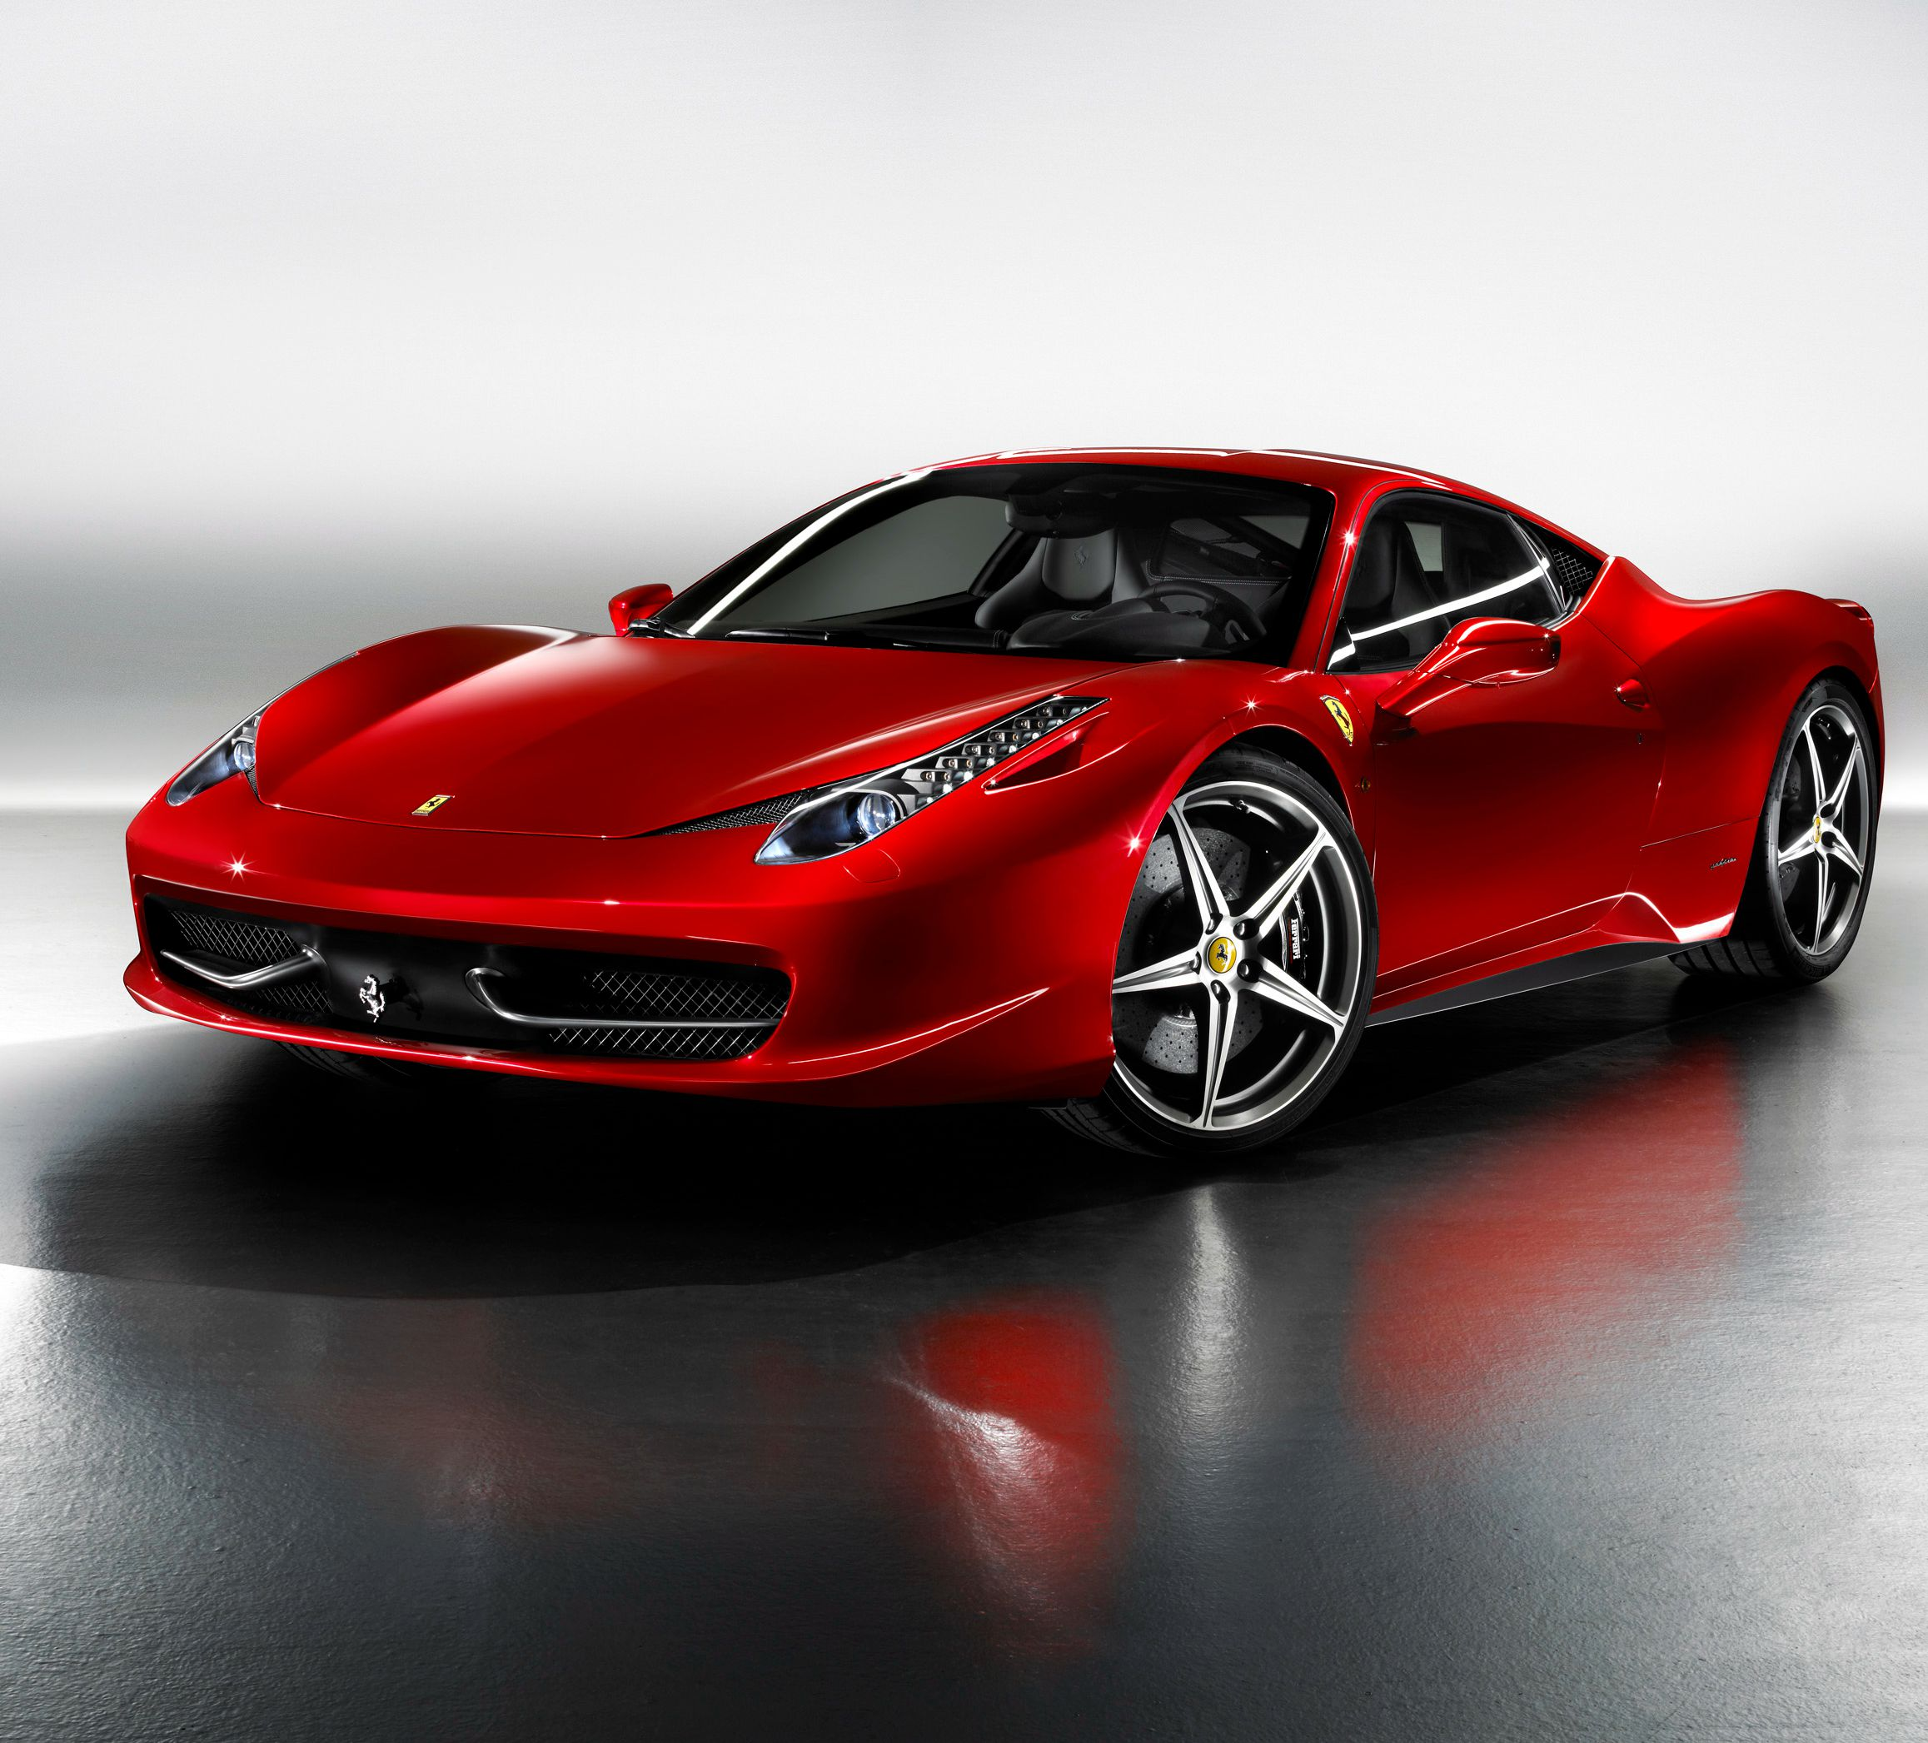
HELLO!
WE ARE HERE TO TELL YOU:
How can you buy a used car in a smart way?
How can you sell your car in a smart way?

Slide 3

ABSTRACT
Introduction
Data description
Problem statement
Methodology
Result & Insights
Conclusion

Slide 4
INTRODUCTION
MARKET SITUATION
Nowadays, second-hand car has become more and more popular in the market.
Customers always have to spend a lot of time and money doing research about the used car market, compare different cars and find the most reasonable price.
IMPORTANCE ®
We are trying to help car sellers sell their car in the desired way they want, they may choose to sell their car in a different location , a different time, ect.
We also trying to help the second car buyers to decide which kind of car worth to buy and make the most of their money.
Here to show how to be a smarter buyer or seller

Slide 5
SOLUTIONS
In order to know how to sell a car or select a used car in the market for a reasonable price, we build three analyzing models based on the used car database containing car attributes and its sales information crawled from eBay website and dataset form demographic database to find out different relationship patterns between 24 attributes and price. We also take “time to sell” as indicator of the rationality of the price.
“time to sell”
Gaussian weighting function
Calculate analytical weight
Add to analyzing models

Slide 6
Dataset Discription
Used car dataset
merge
Demographic Dataset

Slide 7
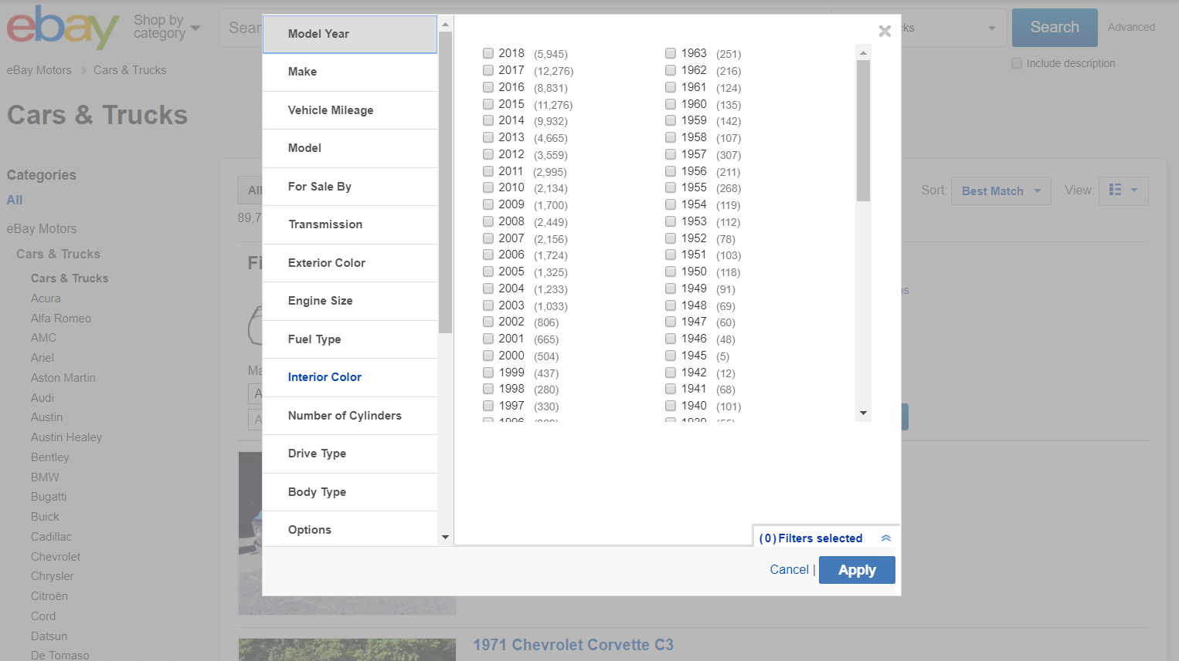
191,540 records
154,049 records
80.4%
Original dataset crawled from ebay
Cleaned Dataset
Data records percentage

Slide 8
ATTRIBUTES
Price VehicleType YearofRegistration GearBox PowerPS Model Kilometer MonthofRegistration FuelType Brand NotRepairedDamage DateCreated PostalCode DateLastSeen DayforSale Weight
DayforSale
PostalCode PlaceName State City Latitude Longtitude Population Area NOofInhabitants
25 Attributes

Slide 9
PROBLEM STATEMENT
ONE
Find out the most important attributes that effect the price of the used car, including demographic attributes
Two
Find out the influence of “time sold out” on the price of used car
Three
Find out the correlation coefficient for each attribute and built a used car price predict model

Slide 10
METHODOLOGY
Data Collection
Data Editting
Data Cleaning
Statistical Adjustment
Analysis Strategy Selection
Regression
Random Tree
Neurel Network
Evaluation&Conclusion

Slide 11
1. Neural Network Model

Slide 12
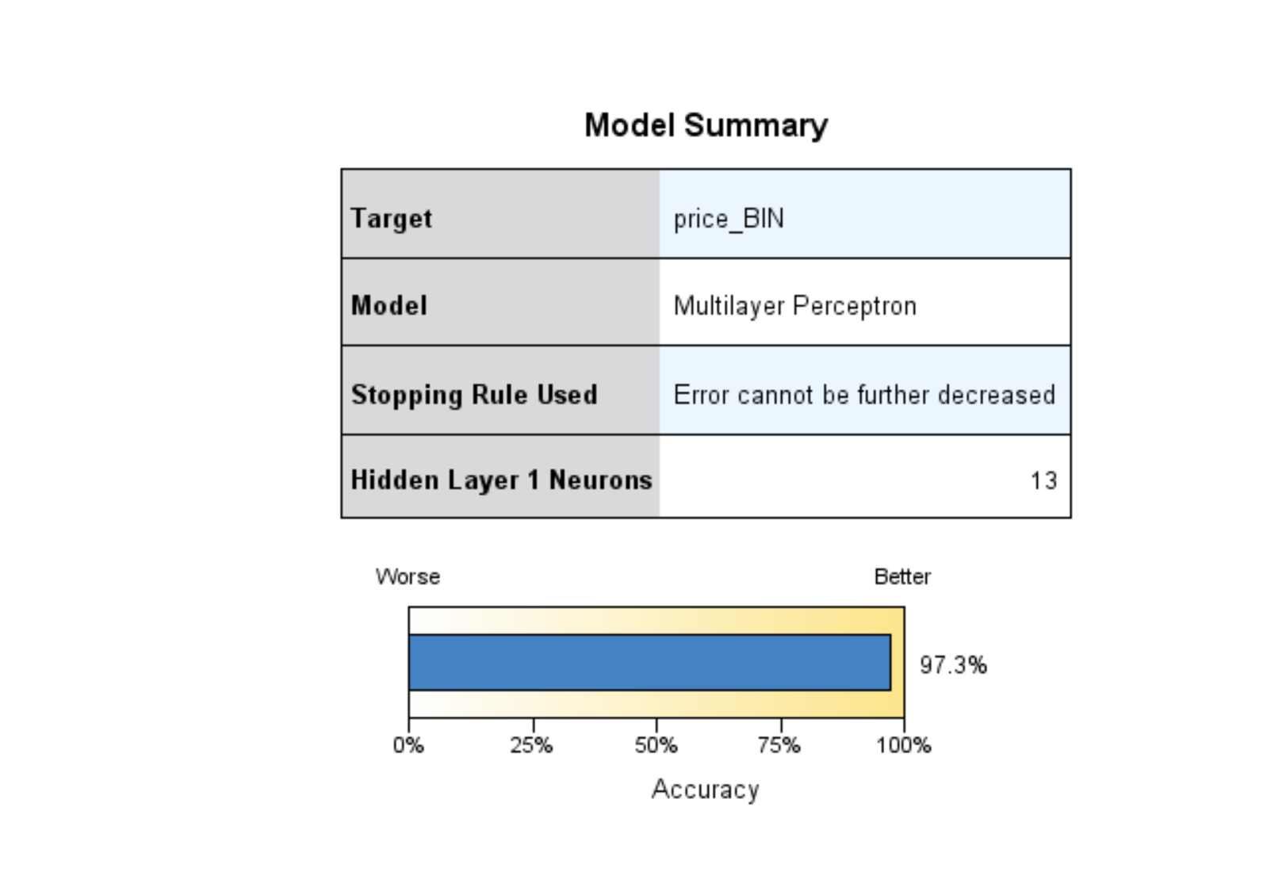
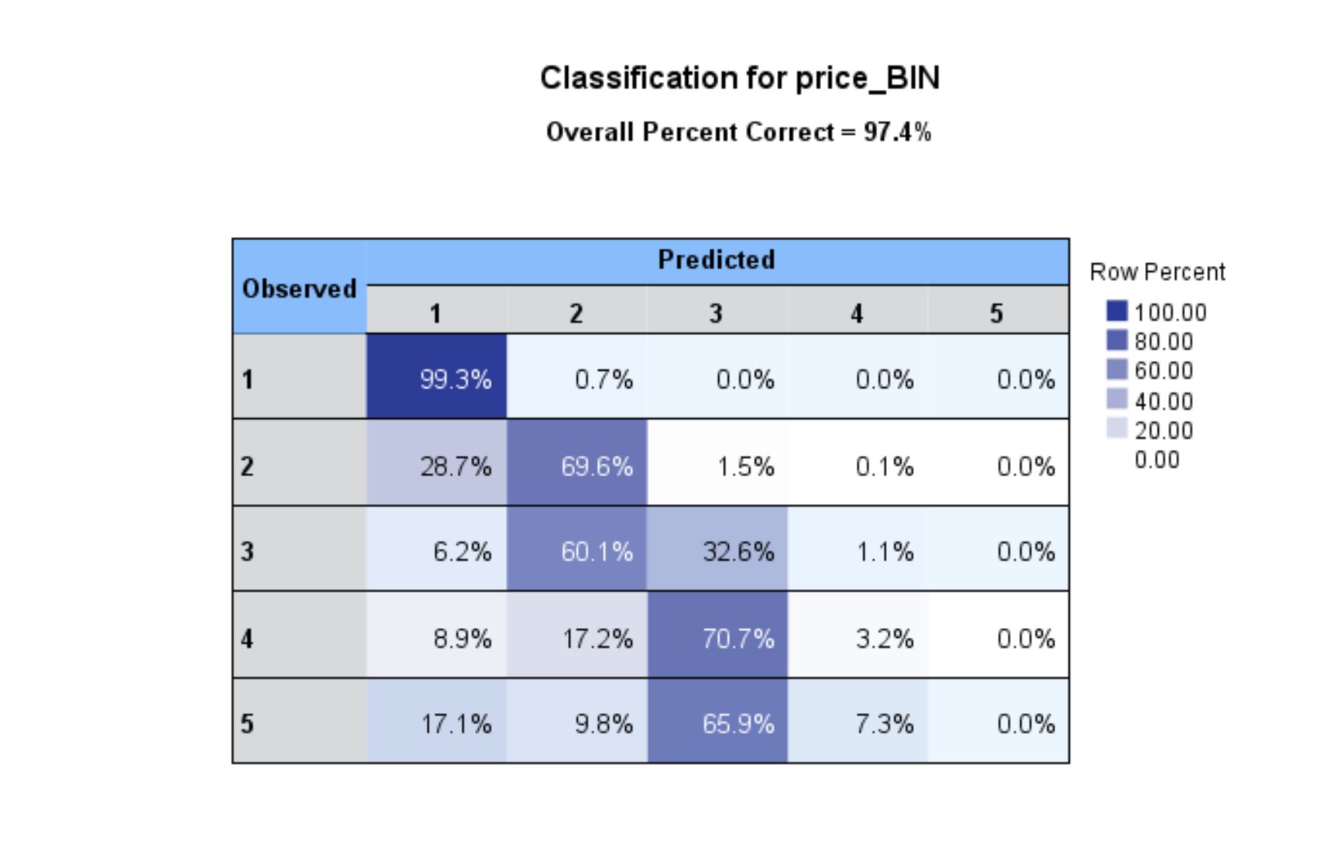
Neural network analysis
Merged 24 attributes
Overall model accuracy 97.3%
Binning to 5 groups based on
$20000 range.
Good performance in category1
category 2

Slide 13
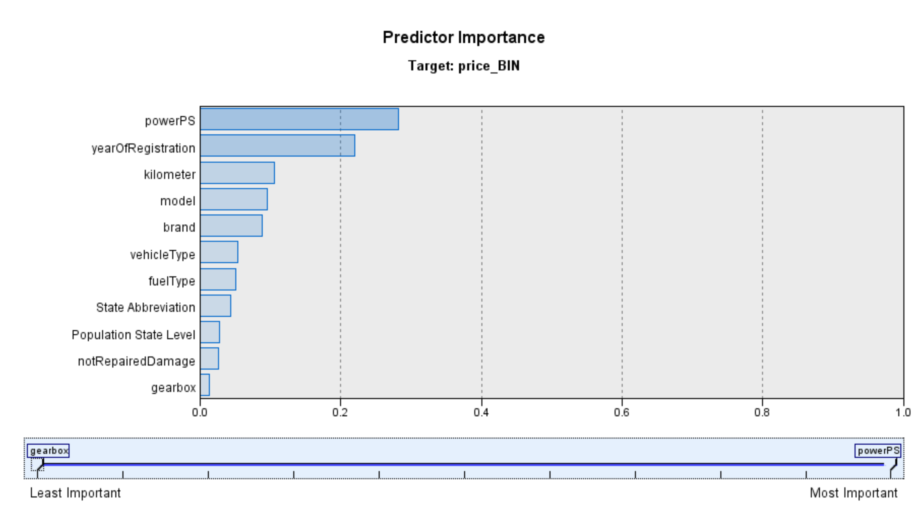
Predict performance of each range of price
Most important predictor of price is powerPS (300PS=223KW) followed by yearofRegistration(YOR) and then kilometer.

Slide 14
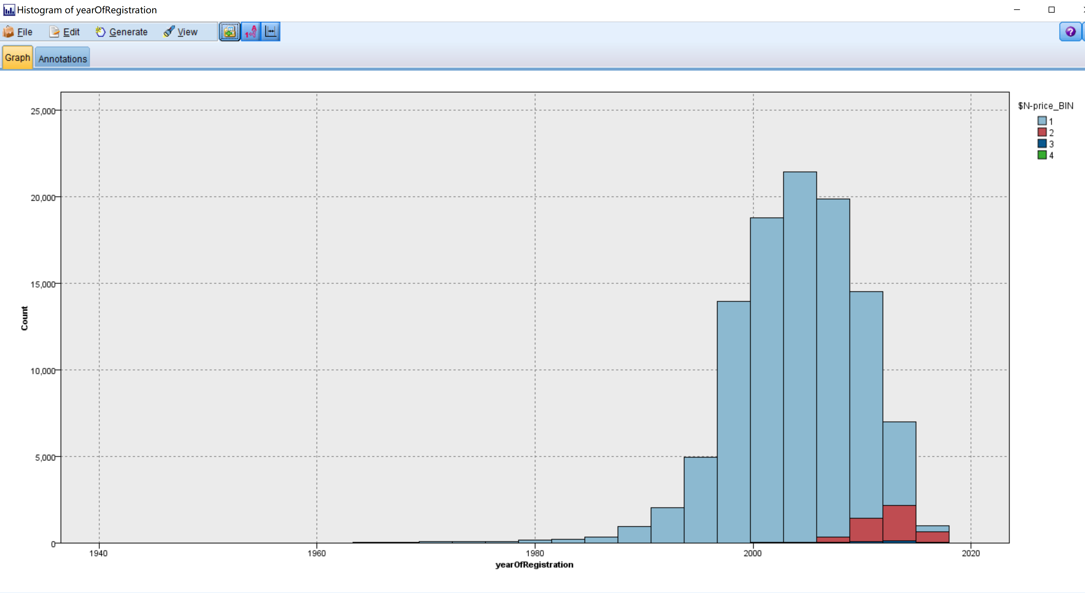
Price –YearOfRegistration analysis
Most category1 cars have the YOR between 1998-2010, while category2 cars are between 2010-2016.
Which means after 6 years of registration, the used car start to devaluate sharply.

Slide 15
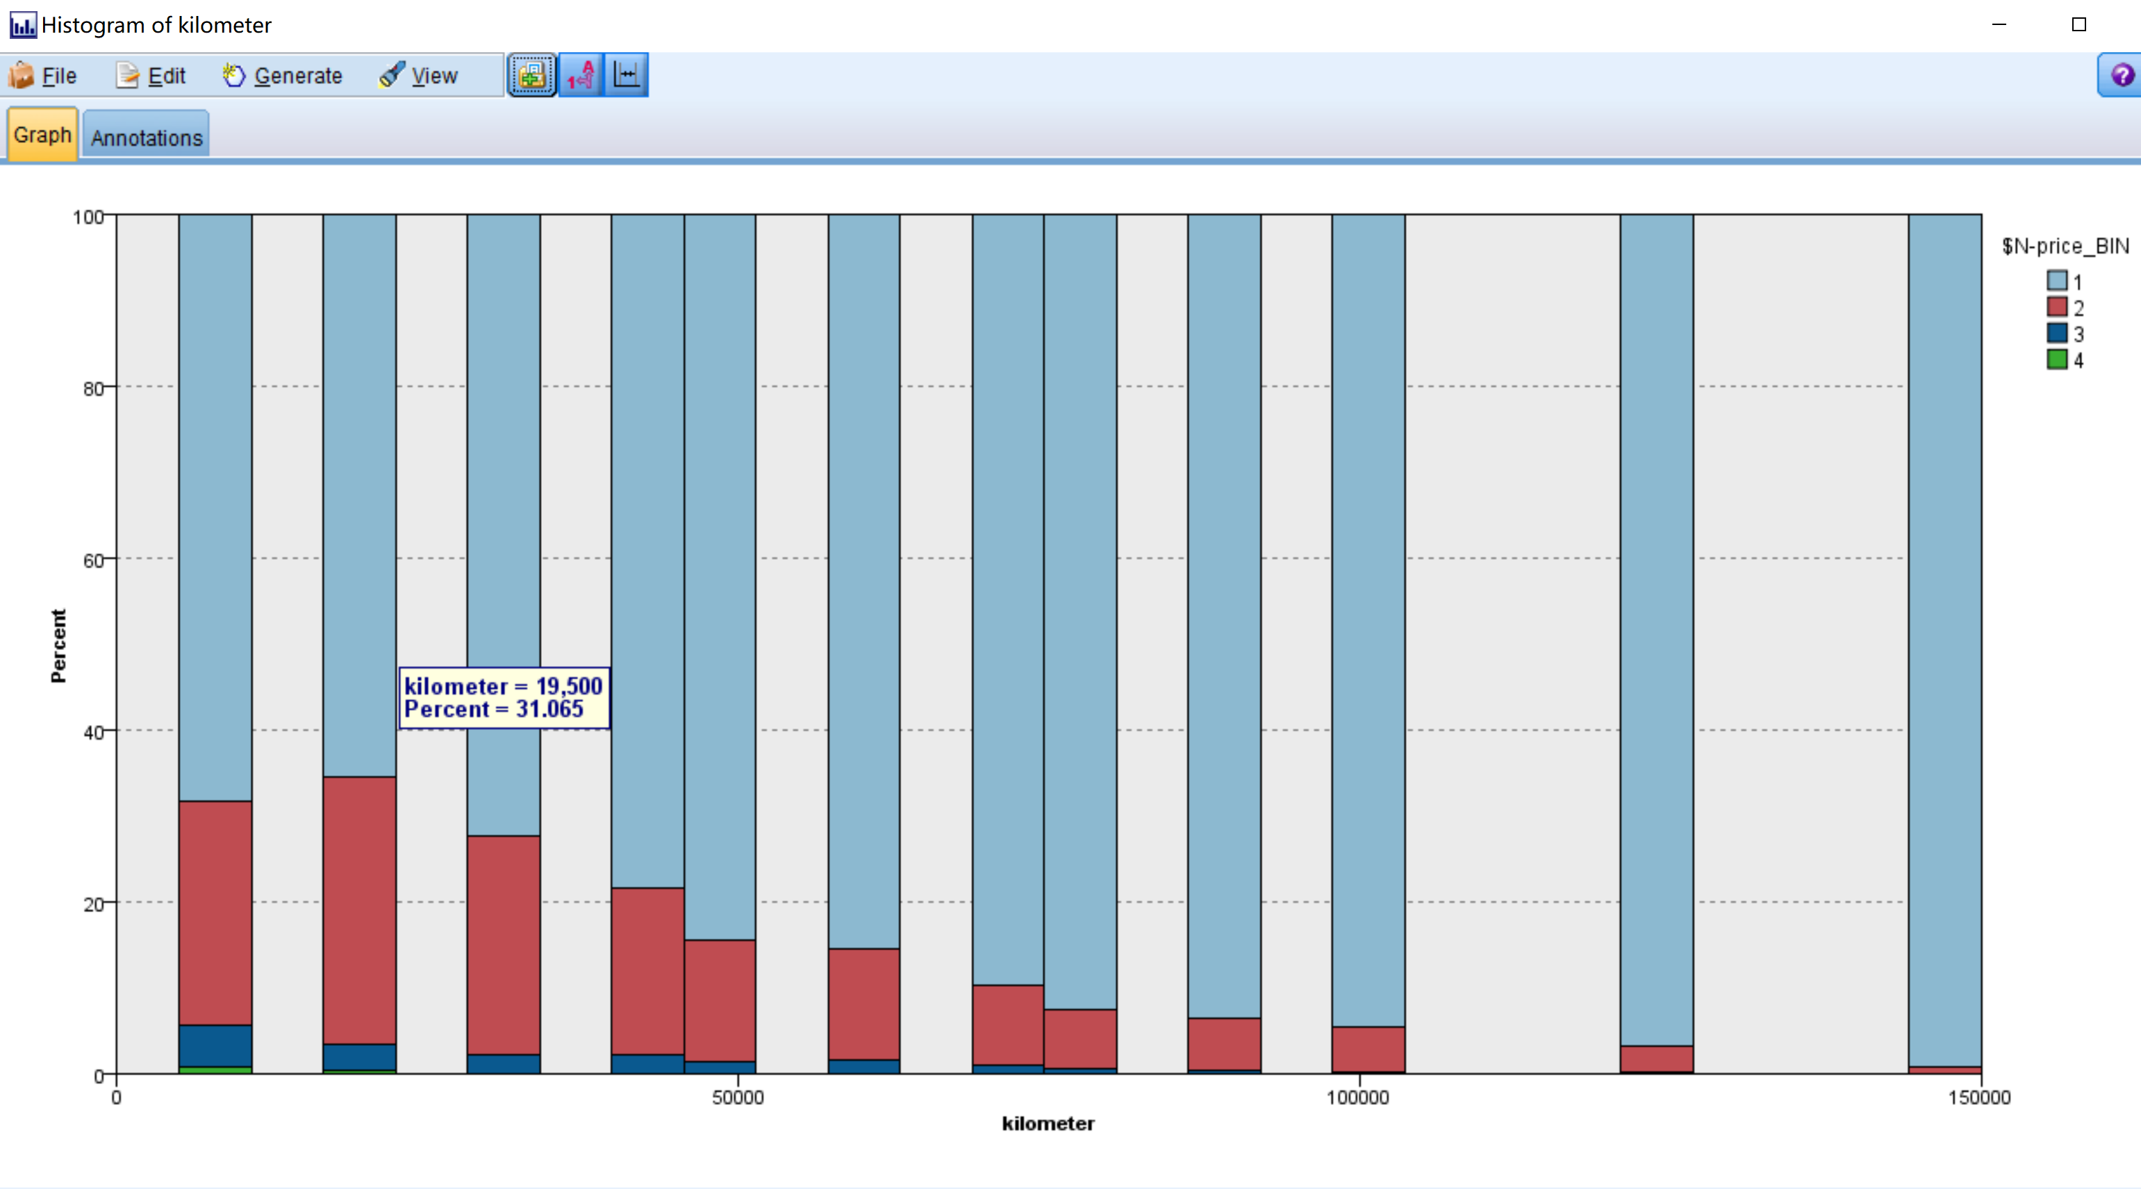
Price-Kilometer analysis
After almost 20000 kilometers, the value of used car will appear negative correlation with mileage.

Slide 16
2. Random Tree Model

Slide 17
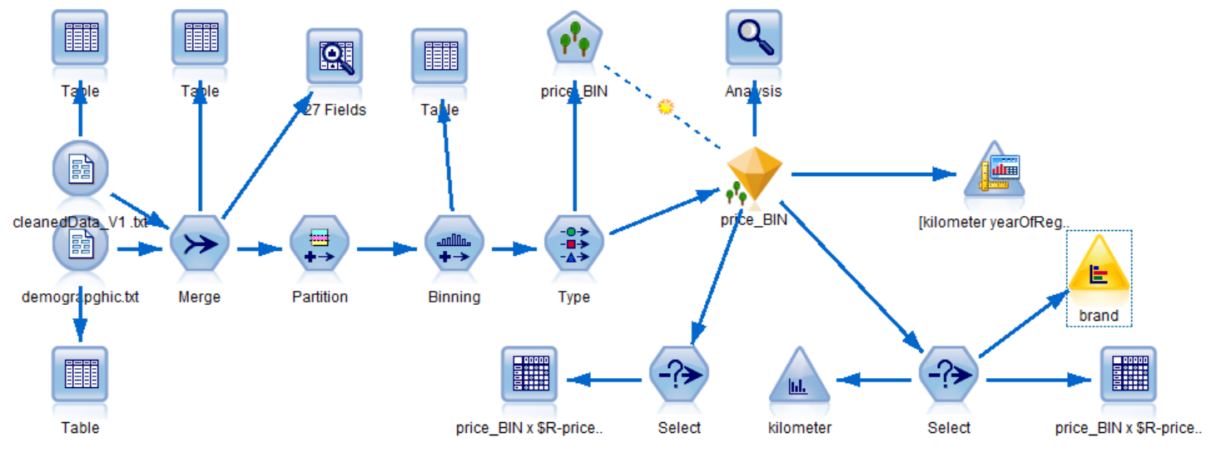
Random Trees Model
Model Stream
Divide price into 5 clusters
Category 1: >= 501 < 20383
Category 2: >= 20383 < 40265
Category 3: >= 40265 < 60147
Category 4: >= 60147 < 80029
Category 5: >= 80029 <= 99911
Price Increase

Slide 18
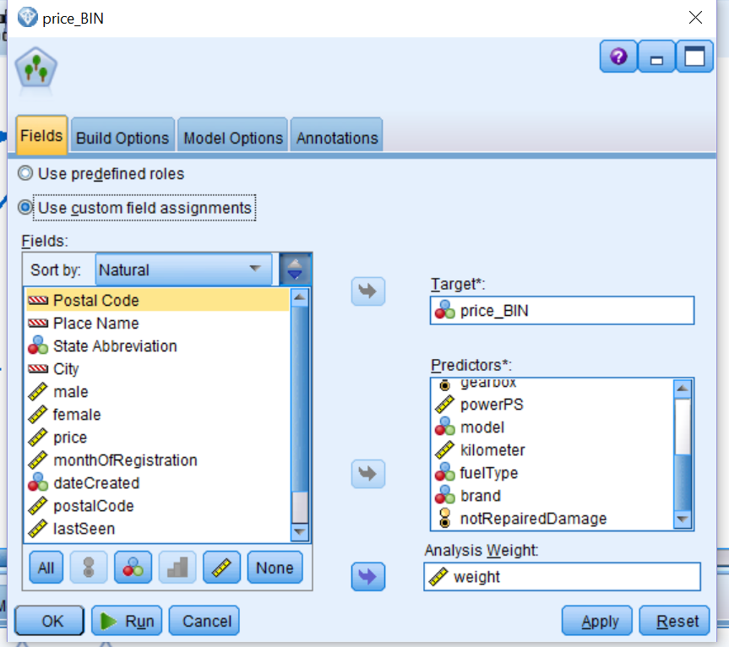

Random Trees Model
Day for Sell
Sale in Short time → too cheap
Sale in long time → too expensive
Gaussian Weighting:
$Weight =$ ${Exp(−(((Day_for_sell_Mean(Day_for_Sell))/SDEV(Day_for_sell))}^{2})/2$

Slide 19
Random Trees Model
Results
 | With weight taken into analysis | Without weight taken into analysis
Overall accuracy | 87.5% | 87%
Top 3 Predictor importance | 1. Brand 2. PowerPS 3. Kilometer | 1. Brand 2. Vehicle 3. PowerPS

Slide 20
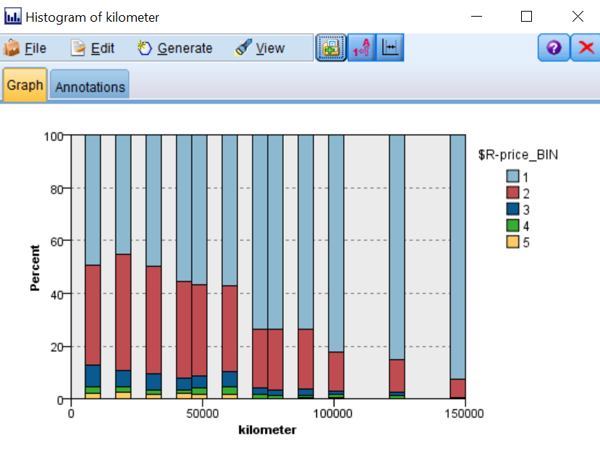
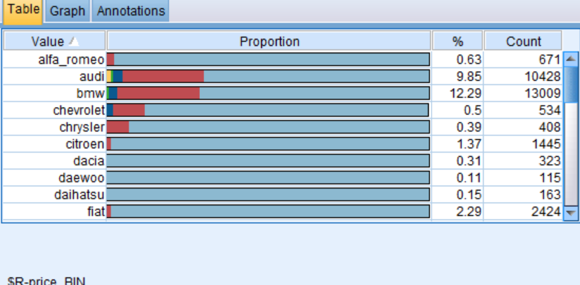
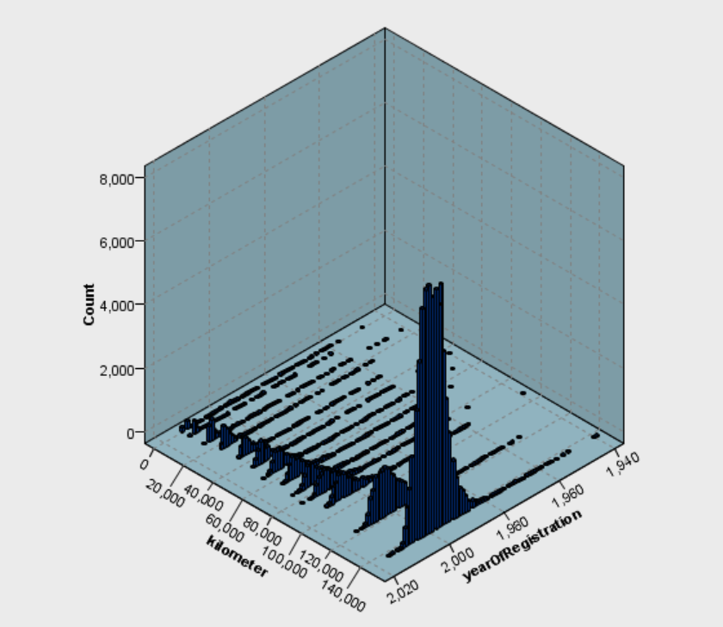
Random Trees Model
Insights based on analysis
How to buy a car in
good cost-performance?
Considerations when buy a car:
kilometers 2. Year of Registration
3. brand
Brand in
Lada, Daihatsu, Daewoo
&
Year of registration around 2000
&
Kilometers around 120000 - 140000

Slide 21
3. Linear Regression Model
Linear Regression focus on the relationship between car price and one or more independent variables

Slide 22
Linear Regression Model 1
Model : SPSS Regression Model
Goal: Predict Market Average Price
Potential User: Car Purchaser
Attribute Inputs:
yearOfRegistration; gearbox; powerPS ;kilometer; brand; notRepariedDamage
Attribute Target :
Price

Slide 23
Days For Sale
Overpriced
Underpriced
Long Sale Time
Short Sale Time

Slide 24
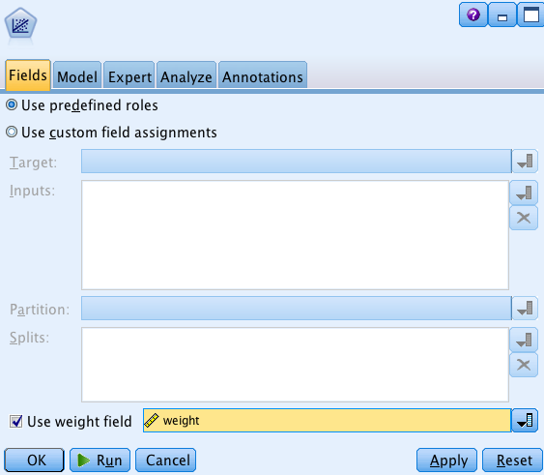
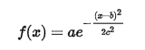
We first adjust our database according to the weight
Gaussian weight function

Slide 25
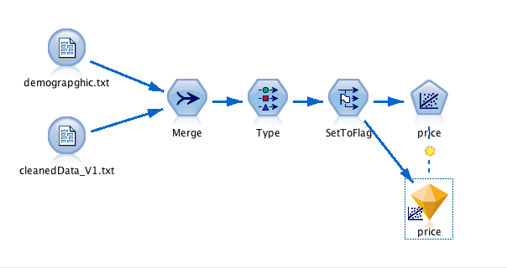
Linear Regression Model 1

Slide 26
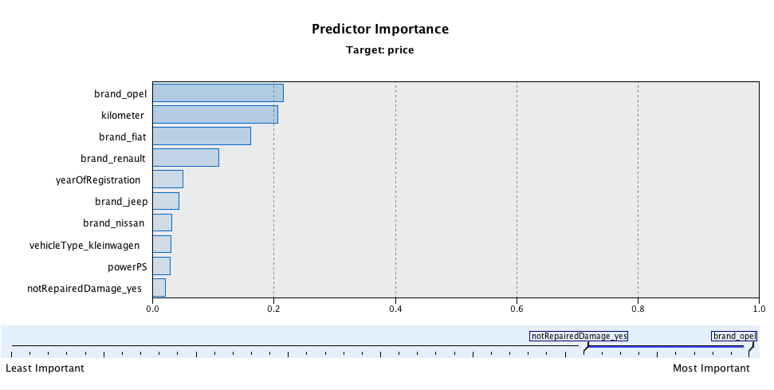
Result － Regression Model 1

Slide 27
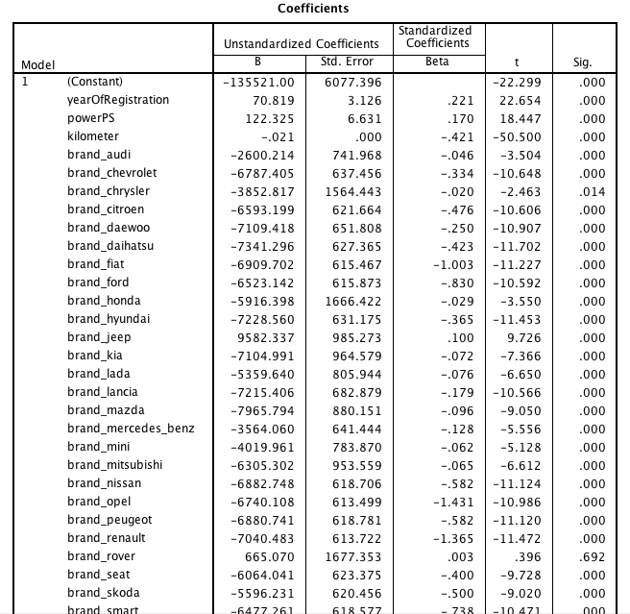
Result － Regression Model 1
Coefficients
💰Price

Slide 28
Linear Regression Model 2
Model : SPSS Regression Model
Goal: Predict Market Price with an assigned time to sale.
Potential User: Car Seller
Attribute Input:
yearOfRegistration; gearbox; powerPS ;kilometer; brand;
notRepariedDamage; dayForSale
Attribute Target:
Price

Slide 29
Linear Regression Model 2

Slide 30
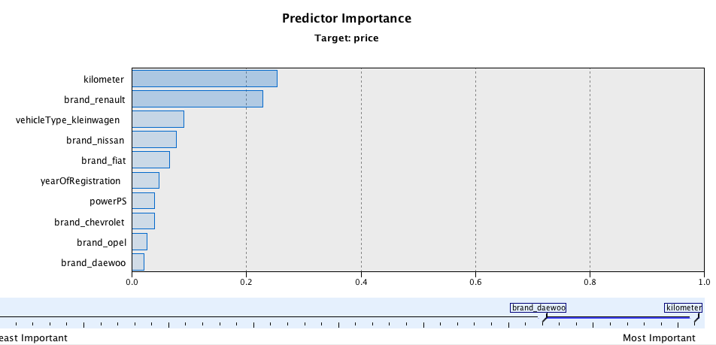
Result - Regression Model 2

Slide 31
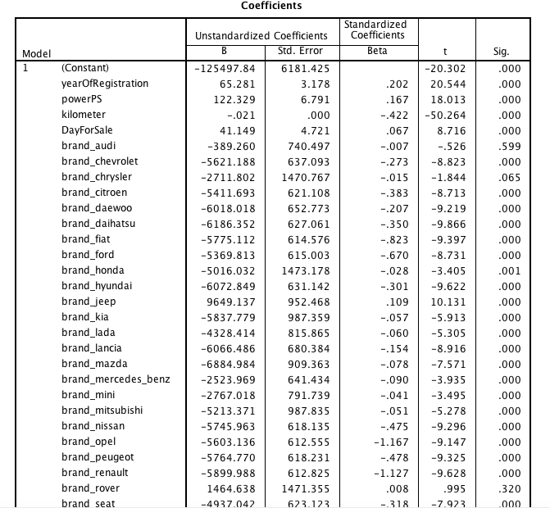
Result - Regression Model 2
Coefficients
＋
💰Price

Slide 32
Insights - FOR BUYER
We recommend you to buy a used car according to :
Brands: Lada Daihatsu Daewo
Kilometers around 120,000 -140,000
Registration year around 2000

Slide 33
Insights - FOR SELLER
You shoud know:
The value of your car start to devaluate sharply after six years and 20000 km you bought it.

Slide 34

Conclusion
1. By identifying the influential predictors, we creates a more healthy and transparent used-car market for both buyer and seller.

Slide 35
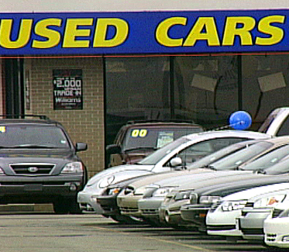
Conclusion
2. Our price prediction model can give both seller and buyer accurate information which improve the overall business efficiency .

Slide 36
THANKS!
ANY QUESTIONS?

Slide 37
CREDITS
Data Source: Orges Leka. Used cars database, 2006
https://www.kaggle.com/orgesleka/used-cars-database/data

